Slide 1
Job Openings and Labor Turnover
Hale Tussing
Econ 174
Time Series Analysis
March 9, 2016

Slide 2
Source and Data
Federal Reserve Bank of St. Louis
National Bureau of Labor Statistics
181 Observations since December 1, 2000
Until March 9, 2016, most recent data point was 4,984,000 Jobs

Slide 3
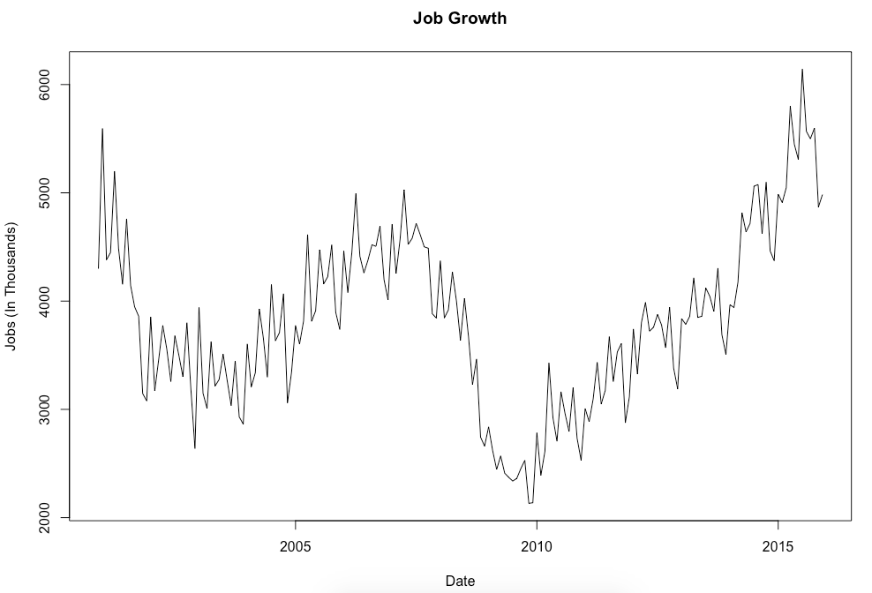
Original Data

Slide 4
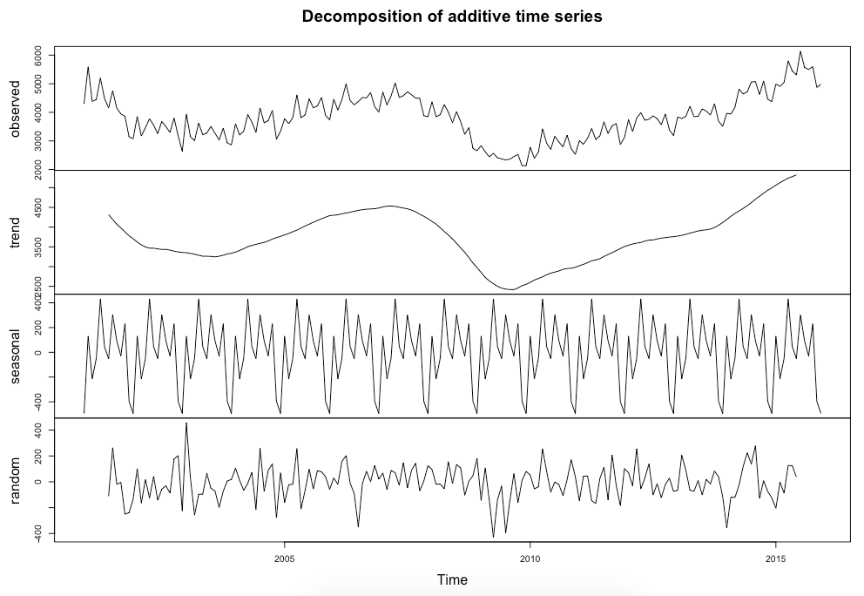
Decomposed Data

Slide 5
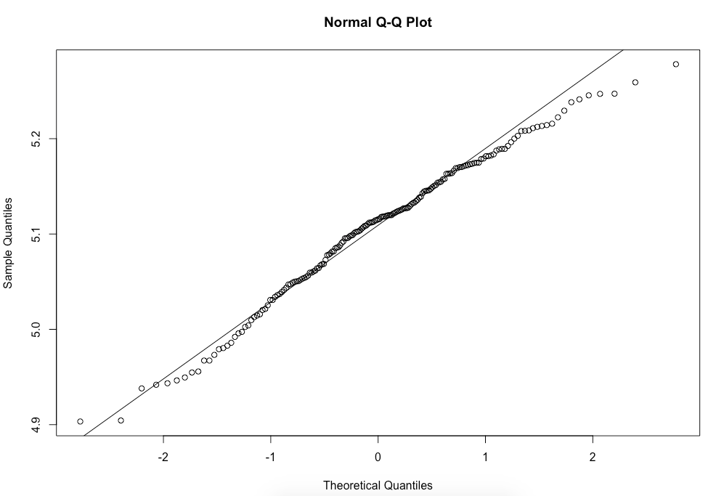
QQ Plot

Slide 6
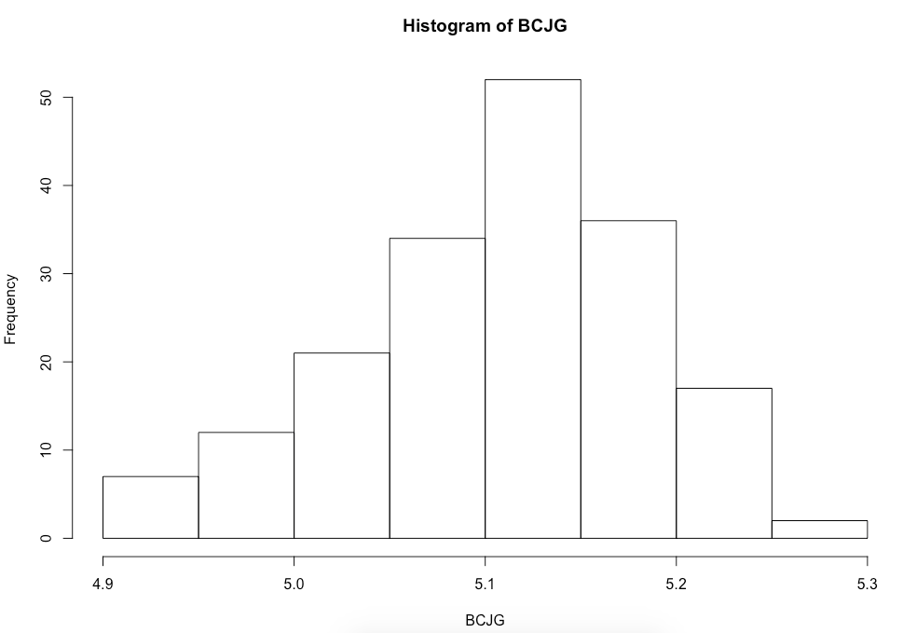
Histogram

Slide 7
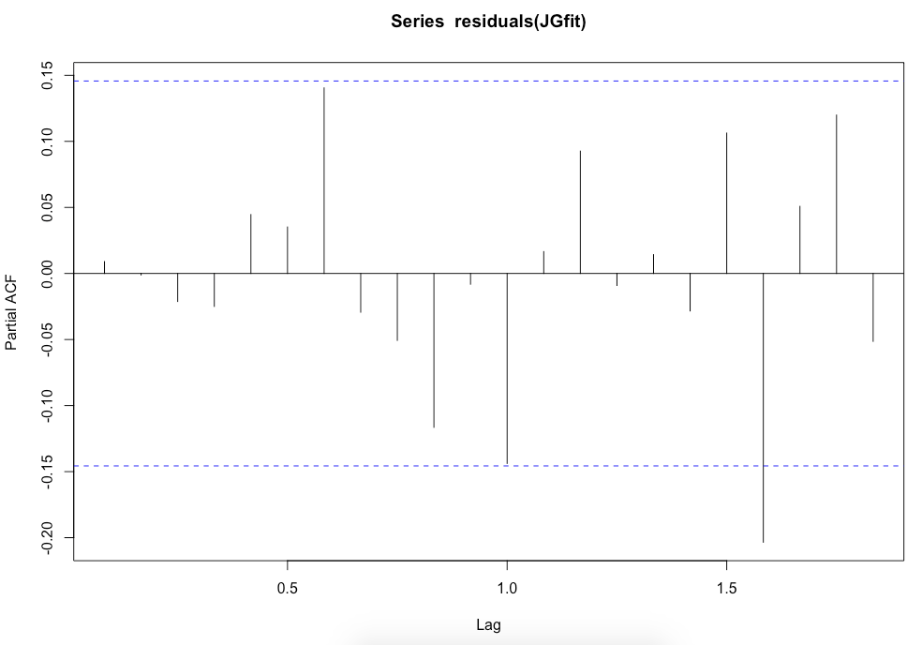
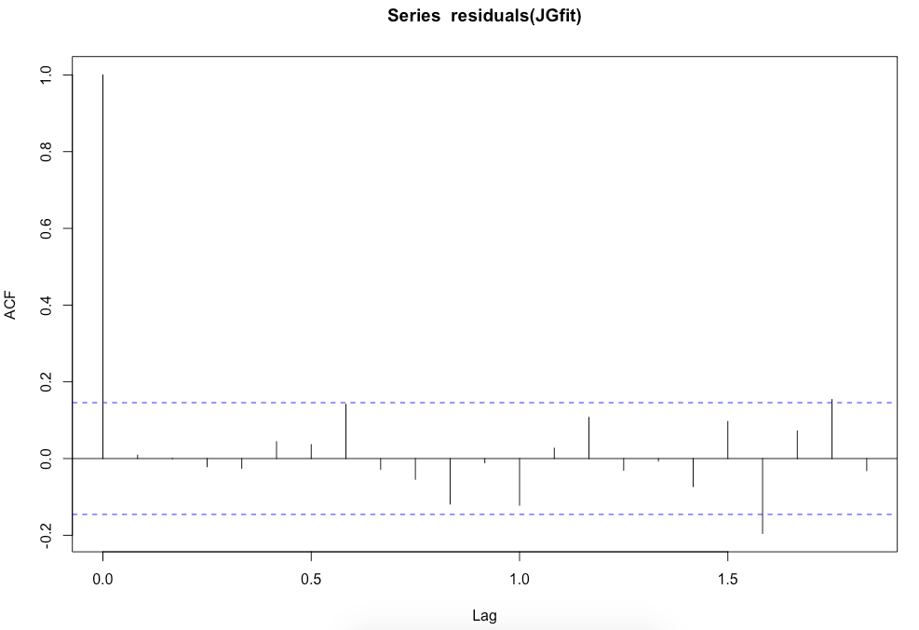
ACF and PACF

Slide 8
R Code Process
In R I named my time series JGts
My forecasting method included using BoxCox to correctly transform the data before using it, along with the lambda for the auto.arima.
After using BoxCox I found that there was no need for differencing
After gaining a lambda of -0.1267472, I looked for the auto arima:
auto.arima(JGts, lambda=-0.1267472)
This gave me ARIMA (3,1,1)(2,0,0)[12] and aic -862.98
I tested p and q of one above and one below, however no aic was lower than my original.
I used the Box-Ljung test to get a p-value of 0.9026

Slide 9
Forecast
Point Forecast Lo 80 Hi 80 Lo 95 Hi 95
Jan 2016 5309.761 4915.646 5739.844 4720.428 5983.318
Feb 2016 5244.433 4812.016 5721.135 4599.468 5993.128
Mar 2016 5524.990 5004.680 6107.059 4751.747 6442.960
Apr 2016 6104.568 5381.647 6938.785 5038.345 7431.921
May 2016 5851.726 5085.445 6750.610 4726.013 7288.796
Jun 2016 5849.900 4999.951 6866.186 4606.953 7483.797
Jul 2016 6358.228 5319.006 7631.951 4847.304 8421.104
Aug 2016 6105.757 5029.959 7447.914 4548.079 8291.094
Sep 2016 5844.130 4740.104 7246.545 4252.171 8140.112
Oct 2016 6112.112 4867.761 7726.642 4326.404 8772.632
Nov 2016 5449.398 4287.152 6979.032 3786.828 7981.196
Dec 2016 5455.127 4225.981 7102.160 3703.850 8196.643

Slide 10
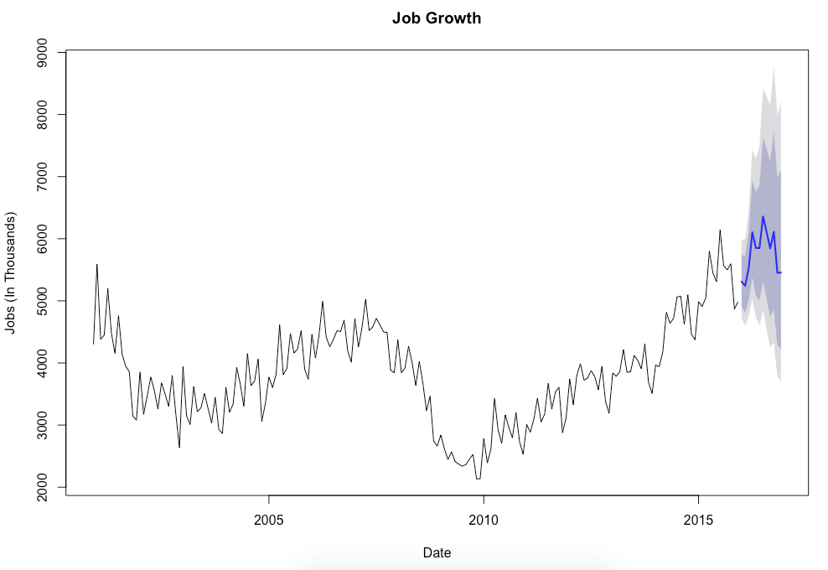
Forecast

Slide 11
Forecast
The most recent point was December 1, 2016 with 4,984,000 Jobs
Using my forecast, I predict the next data point will be 5,309,761 Jobs in January 1, 2016

